Slide 1
Recommender Systems & Embeddings
Jin Lu – UMDearborn

Slide 2
Outline
Embeddings

Slide 3
Outline
Embeddings
Dropout Regularization

Slide 4
Outline
Embeddings
Dropout Regularization
Recommender Systems

Slide 5
Embeddings

Slide 6
Embeddings
Symbolic variable
Text: characters, words, bigrams...
Recommender Systems: item ids, user ids
Any categorical descriptor: tags, movie genres, visited URLs, skills on a resume, product categories...

Slide 7
Embeddings
Symbolic variable
Text: characters, words, bigrams...
Recommender Systems: item ids, user ids
Any categorical descriptor: tags, movie genres, visited URLs, skills on a resume, product categories...

Slide 8
Embeddings
Symbolic variable
Text: characters, words, bigrams...
Recommender Systems: item ids, user ids
Any categorical descriptor: tags, movie genres, visited URLs, skills on a resume, product categories...

Slide 9
Embeddings
Symbolic variable
Text: characters, words, bigrams...
Recommender Systems: item ids, user ids
Any categorical descriptor: tags, movie genres, visited URLs, skills on a resume, product categories...
Notation:
Symbol s in vocabulary V
Notes:
More difficult for machines to learn continuous variables
Need to connect them with symbolic variables (because they numerical, which is easier for machines to use/learn from).
Need to encode ideas numerically.

Slide 10
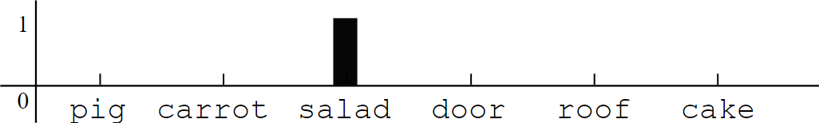
One-hot representation
onehot('salad')=[0,0,1,...,0]∈ 0,1
𝑉
Notes:
One-hot = one hot vector to represent output values

Slide 11
One-hot representation
onehot('salad')=[0, 0, 1, ..., 0]∈ 0, 1
𝑉
Sparse, discrete, large dimension 𝑉
Each axis has a meaning
Symbols are equidistant from each other:
euclidean distance = 2
Notes:
Sparse vector = most entries = 0
Equidistance is important, we do not want to introduce any bias during our encoding of any value

Slide 12
Embedding
embedding('salad’)=[3.28, -0.45,…,7.11]∈𝑅^{𝑑}

Slide 13
Embedding
embedding('salad’)=[3.28, -0.45,…,7.11]∈𝑅^{𝑑}
Continuous and dense
Can represent a huge vocabulary in low dimension, typically: 𝑑 ∈ {16, 32, … , 4096}
Embedding metric can capture semantic distance
Axis have no meaning a priori
Notes:
Embedding allows for you to capture some semantic distance → all symbols are not equidistant from each other.

Slide 14
Embedding
embedding('salad’)=[3.28, -0.45,…,7.11]∈𝑅^{𝑑}
Continuous and dense
Can represent a huge vocabulary in low dimension, typically: 𝑑 ∈ {16, 32, … , 4096}
Embedding metric can capture semantic distance
Axis have no meaning a priori
Neural Networks compute transformations on continuous vectors
Notes:
Typically d is a multiple of 2 (since memory is managed in binary)

Slide 15
Implementation with Keras
Size of vocabulary 𝑛 = |𝑉|, size of embedding 𝑑
# input: batch of integers
Embedding(output_dim=d, input_dim=n, input_length=1)
# output: batch of float vectors

Slide 16
Implementation with Keras
Size of vocabulary 𝑛 = |𝑉|, size of embedding 𝑑
# input: batch of integers
Embedding(output_dim=d, input_dim=n, input_length=1)
# output: batch of float vectors
Equivalent to one-hot encoding multiplied by a weight matrix 𝐖 ∈ 𝑅^{𝑛×𝑑}:
𝑒𝑚𝑏𝑒𝑑𝑑𝑖𝑛𝑔(𝑥) = 𝑜𝑛𝑒ℎ𝑜𝑡(𝑥). 𝐖

Slide 17
Implementation with Keras
Size of vocabulary 𝑛 = |𝑉|, size of embedding 𝑑
# input: batch of integers
Embedding(output_dim=d, input_dim=n, input_length=1)
# output: batch of float vectors
Equivalent to one-hot encoding multiplied by a weight matrix 𝐖 ∈ 𝑅^{𝑛×𝑑}:
𝑒𝑚𝑏𝑒𝑑𝑑𝑖𝑛𝑔(𝑥) = 𝑜𝑛𝑒ℎ𝑜𝑡(𝑥). 𝐖
𝐖 is typically randomly initialized, then tuned by backprop

Slide 18
Implementation with Keras
Size of vocabulary 𝑛 = |𝑉|, size of embedding 𝑑
# input: batch of integers
Embedding(output_dim=d, input_dim=n, input_length=1)
# output: batch of float vectors
Equivalent to one-hot encoding multiplied by a weight matrix 𝐖 ∈ 𝑅^{𝑛×𝑑}:
𝑒𝑚𝑏𝑒𝑑𝑑𝑖𝑛𝑔(𝑥) = 𝑜𝑛𝑒ℎ𝑜𝑡(𝑥). 𝐖
𝐖 is typically randomly initialized, then tuned by backprop
𝐖 are trainable parameters of the model.
Notes:
If new words introduced, need to retrain the model (the weights w)

Slide 19
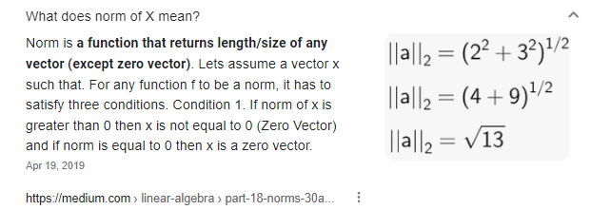
Distance and similarity in Embedding
space
Euclidean distance
𝒅 𝒙, 𝒚
= 𝒙 − 𝒚
𝟐
Simple with good properties
Dependent on norm (embeddings usually unconstrained)
Notes:
Note, variables x and y in all of these slides are referring to vectors most of the time, including above.

Slide 20
Distance and similarity in Embedding
space
Euclidean distance
Cosine similarity
𝒅 𝒙, 𝒚
= 𝒙 − 𝒚
𝒙 ⋅ 𝒚
𝟐
𝒄𝒐𝒔𝒊𝒏𝒆 𝒙, 𝒚 =
𝒙 ⋅ 𝒚
Simple with good properties
Dependent on norm (embeddings usually unconstrained)
Angle between points, regardless of norm
𝒄𝒐𝒔𝒊𝒏𝒆 𝒙, 𝒚 ∈ [−𝟏, 𝟏]
Expected cosine similarity of random pairs of vectors is 0
Notes:
Most dissimilar with cosine similarity will give output of -1
Most similar gives output of 1
Thus average similarity value for random pairs should = 0

Slide 21
Distance and similarity in Embedding
space
If 𝑥 and 𝑦 both have unit norms:
‖𝒙 − 𝒚‖^{𝟐} = 𝟐(𝟏 − 𝒄𝒐𝒔𝒊𝒏𝒆(𝒙, 𝒚))
𝟐

Slide 22
Distance and similarity in Embedding
space
If 𝑥 and 𝑦 both have unit norms:
‖𝒙 − 𝒚‖^{𝟐} = 𝟐(𝟏 − 𝒄𝒐𝒔𝒊𝒏𝒆(𝒙, 𝒚))
𝟐
or alternatively:
‖𝒙 − 𝒚‖^{𝟐}
𝒄𝒐𝒔 𝒙, 𝒚 = 𝟏 − ^{𝟐}
𝟐

Slide 23
Distance and similarity in Embedding
space
If 𝑥 and 𝑦 both have unit norms:
‖𝒙 − 𝒚‖^{𝟐} = 𝟐(𝟏 − 𝒄𝒐𝒔𝒊𝒏𝒆(𝒙, 𝒚))
𝟐
or alternatively:
‖𝒙 − 𝒚‖^{𝟐}
𝒄𝒐𝒔 𝒙, 𝒚 = 𝟏 − ^{𝟐}
𝟐
Alternatively, dot product (unnormalized) is used in practice as a pseudo similarity

Slide 24
Visualizing Embeddings
Visualizing requires a projection in 2 or 3 dimensions
Objective: visualize which embedded symbols are similar

Slide 25
Visualizing Embeddings
Visualizing requires a projection in 2 or 3 dimensions
Objective: visualize which embedded symbols are similar
PCA
Limited by linear projection, embeddings usually have complex high dimensional
structure

Slide 26
Visualizing Embeddings
Visualizing requires a projection in 2 or 3 dimensions
Objective: visualize which embedded symbols are similar
PCA
Limited by linear projection, embeddings usually have complex high dimensional
structure
t-SNE
Visualizing data using t-SNE, L van der Maaten, G Hinton, The Journal of Machine Learning Research, 2008
Notes:
PCA guarantees best linear projection that preserves the most features from the higher dimension to the lower dimension
t-SNE tries to keep data closely grouped that to still show/preserve possibly more features during projection than PCA

Slide 27
t-Distributed Stochastic Neighbor Embedding
Unsupervised, low-dimension, non-linear projection
Optimized to preserve relative distances between nearest neighbors
Global layout is not necessarily meaningful

Slide 28
t-Distributed Stochastic Neighbor Embedding
Unsupervised, low-dimension, non-linear projection
Optimized to preserve relative distances between nearest neighbors
Global layout is not necessarily meaningful
SNE projection is non deterministic (depends on initialization) (slightly different result after each run even with same data inputs; but PCA guarantees same projection output with same data inputs)
Critical parameter: perplexity, usually set to 20, 30
See http://distill.pub/2016/misread-tsne/

Slide 29
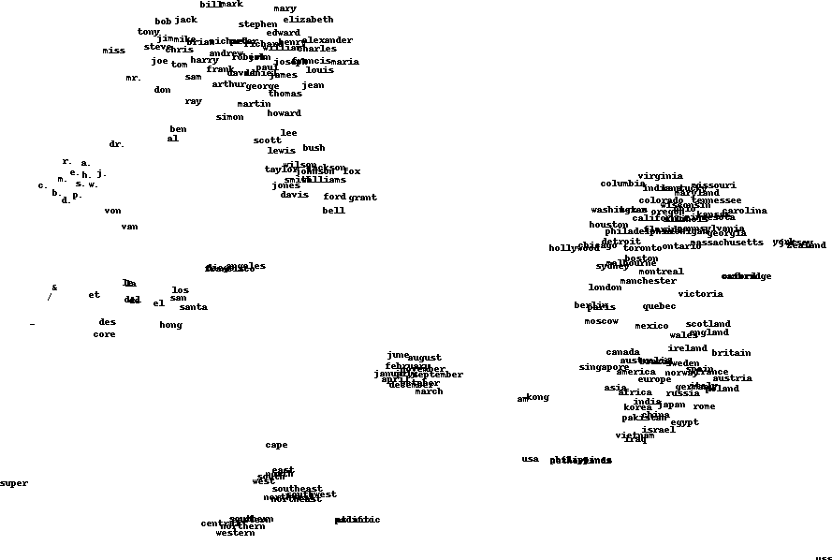
Example word vectors

Slide 30
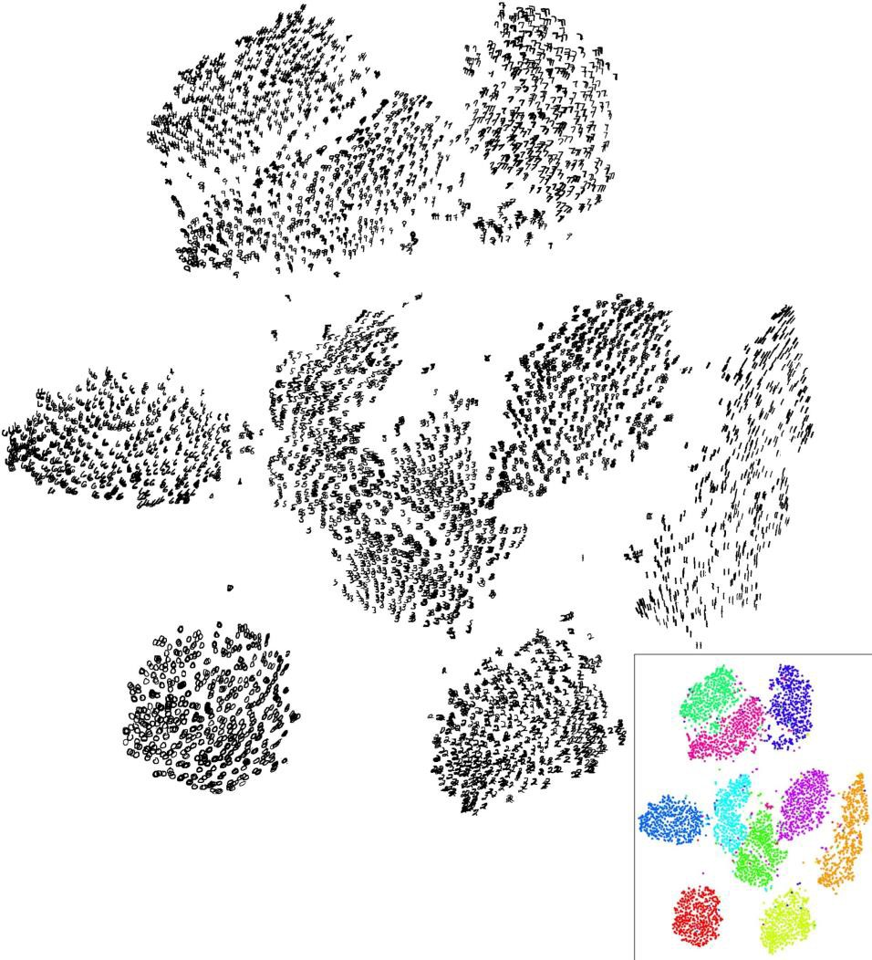
Visualizing Mnist

Slide 31
Dropout Regularization

Slide 32
Regularization
Size of the embeddings

Slide 33
Regularization
Size of the embeddings
Depth of the network

Slide 34
Regularization
Size of the embeddings
Depth of the network
𝐿₂ penalty on embeddings

Slide 35
Regularization (used to combat/prevent overfitting from having too many parameters = model too complex)
Size of the embeddings
Depth of the network
𝐿₂ penalty on embeddings
Dropout
Randomly set activations to 0 with probability p (randomly ignoring outputs)
Bernoulli mask sampled for a forward pass / backward pass pair
Typically only enabled at training time
Notes:
Methods to implement Dropout:
Do not wait for training loss to reach its converged value, simply stop when validation loss is at a minimum since after minimum then validation loss starts to increase again.
Noise injection (data augmentation) can also be used to implement regularization → collect more data and feed it to model.
Model combination Drop

Slide 36
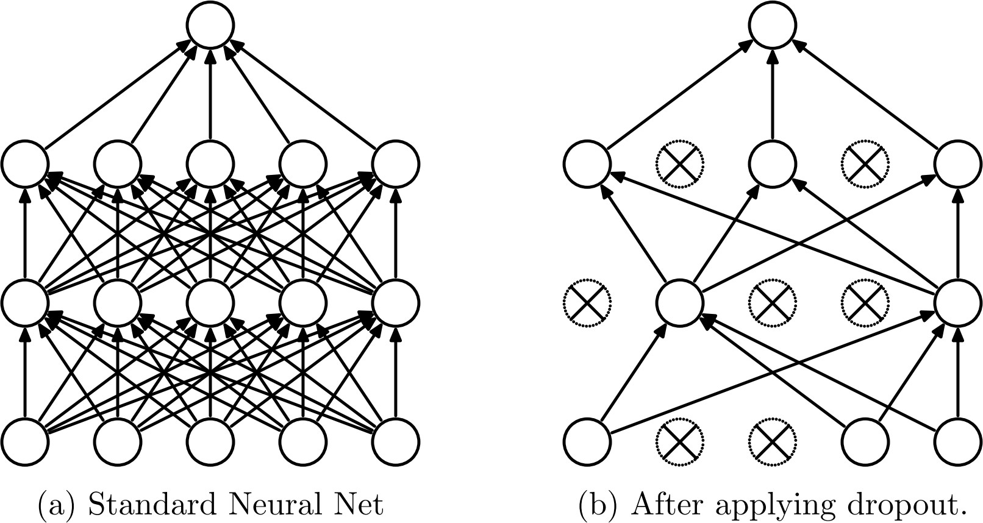
Dropout (prevent overfitting during training by deactivating nodes)
Dropout: A Simple Way to Prevent Neural Networks from Overfitting, Srivastava et al., Journal of Machine Learning Research 2014

Slide 37
Dropout
Interpretation
Reduces the network dependency to individual neurons
More redundant representation of data
Ensemble interpretation
Equivalent to training a large ensemble of shared- parameters, binary-masked models (every time model is trained by a data point, randomly select with probability p the number of nodes to drop for next iteration/training with next data point – note, nodes are selected randomly as well)
Each model is only trained on a single data point

Slide 38


Dropout
(Image a)
(Image b)
The weight on each unit will initially be ¼ = 0.25.
If we apply dropout with p = 0.5 to this layer, it could end up looking like image b. Since only two units are considered, they will each have an initial weight of ½ = 0.5. But we don’t want these weights to be fixed at this high number during testing.
Dropout: A Simple Way to Prevent Neural Networks from Overfitting, Srivastava et al., Journal of Machine Learning Research 2014
Notes:
Overfitting: causes high accuracy on training data, but very bad accuracy on validation on test data.
This is because when you overfit, then it is like the model really merely memorized; so you need to do dropout to help prevent overfitting.

Slide 39
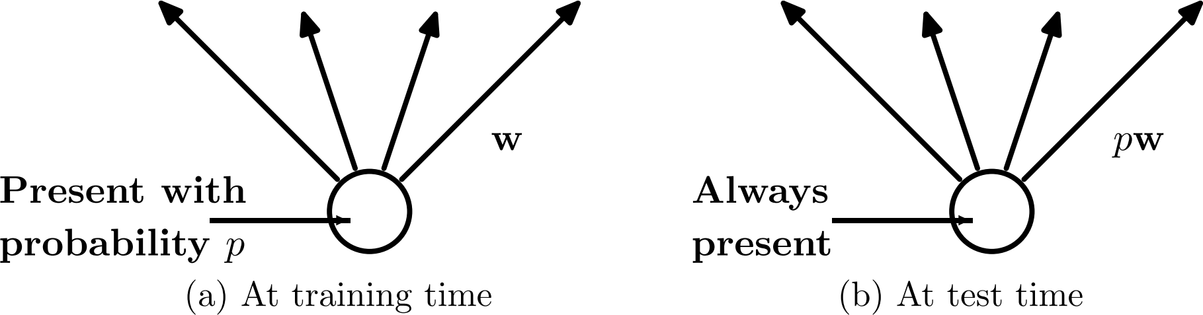
Dropout
At test time, multiply weights by p to keep same level of activation
Dropout: A Simple Way to Prevent Neural Networks from Overfitting, Srivastava et al., Journal of Machine Learning Research 2014

Slide 40
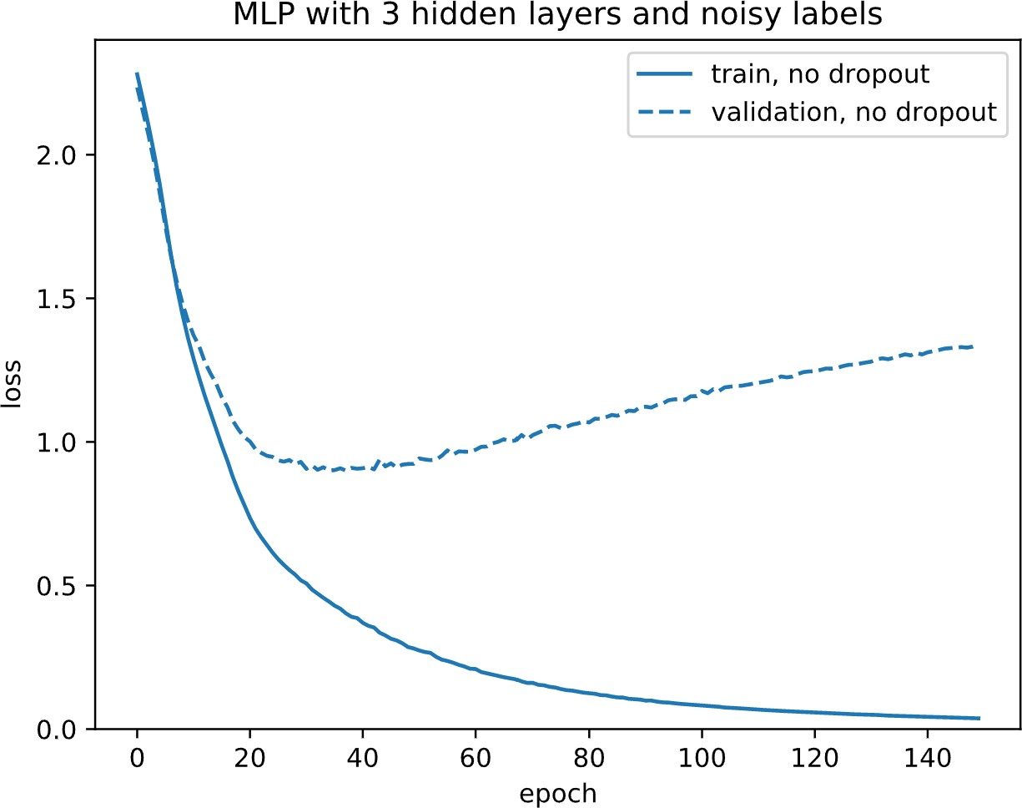
Overfitting Noise

Slide 41
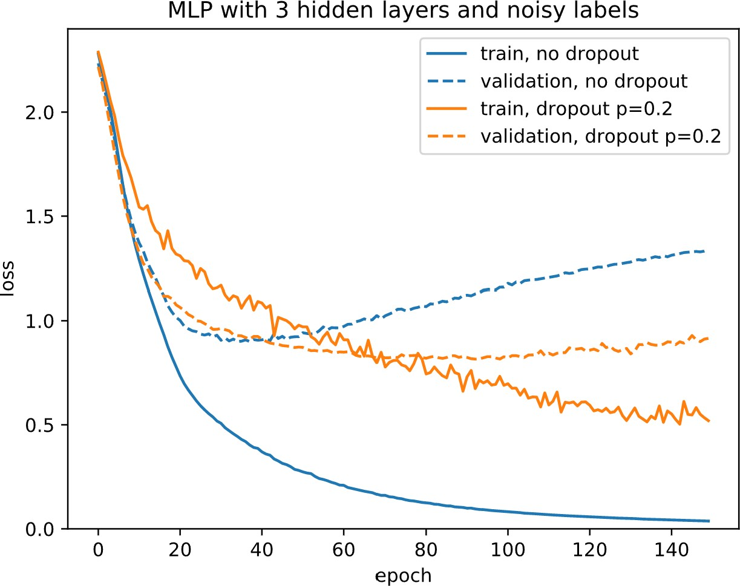
Overfitting Noise

Slide 42
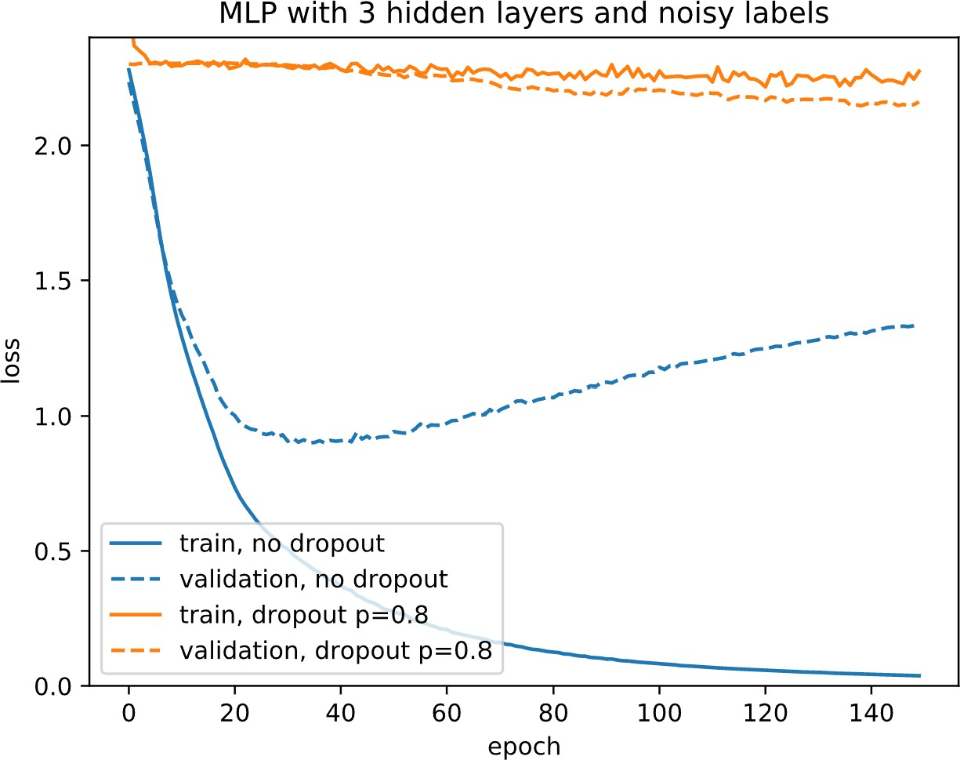
Overfitting Noise

Slide 43
Implementation with Keras
model = Sequential()
model.add(Dense(hidden_size, input_shape,
activation='relu'))
model.add(Dropout(p=0.5))
model.add(Dense(hidden_size, activation='relu'))
model.add(Dropout(p=0.5))
model.add(Dense(output_size, activation='softmax'))

Slide 44
Recommendation Systems

Slide 45
Recommendation Systems
Recommend contents and products
Movies on Netflix and YouTube, weekly playlist and related Artists on Spotify, books on Amazon, related apps on app stores, "Who to Follow" on twitter...

Slide 46
Recommendation Systems
Recommend contents and products
Movies on Netflix and YouTube, weekly playlist and related Artists on Spotify, books on Amazon, related apps on app stores, "Who to Follow" on twitter...
Prioritized social media status updates

Slide 47
Recommendation Systems
Recommend contents and products
Movies on Netflix and YouTube, weekly playlist and related Artists on Spotify, books on Amazon, related apps on app stores, "Who to Follow" on twitter...
Prioritized social media status updates Personalized search engine results

Slide 48
Recommendation Systems
Recommend contents and products
Movies on Netflix and YouTube, weekly playlist and related Artists on Spotify, books on Amazon, related apps on app stores, "Who to Follow" on twitter...
Prioritized social media status updates
Personalized search engine results Personalized ads

Slide 49
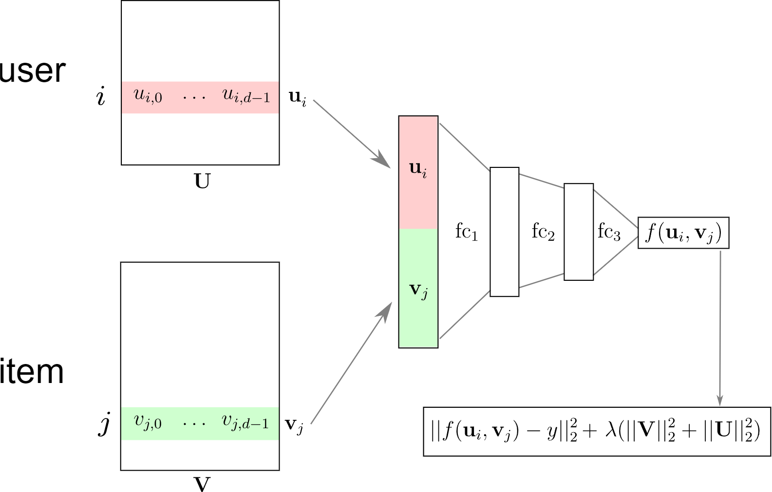
Deep RecSys Architecture

Slide 50
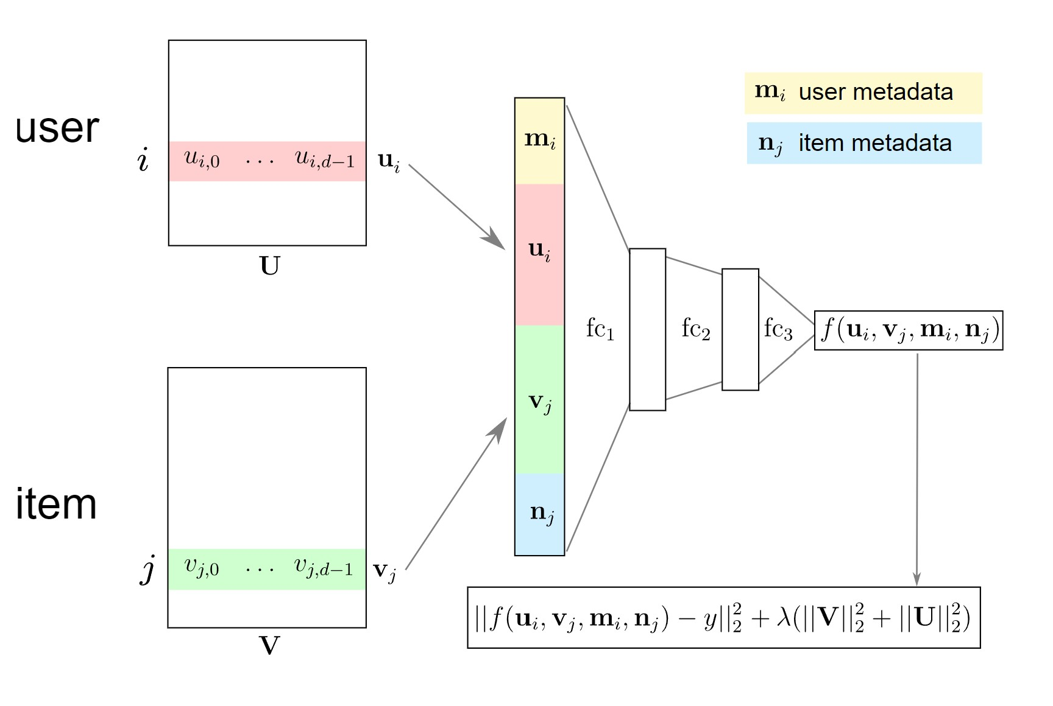
Deep RecSys with metadata

Slide 51
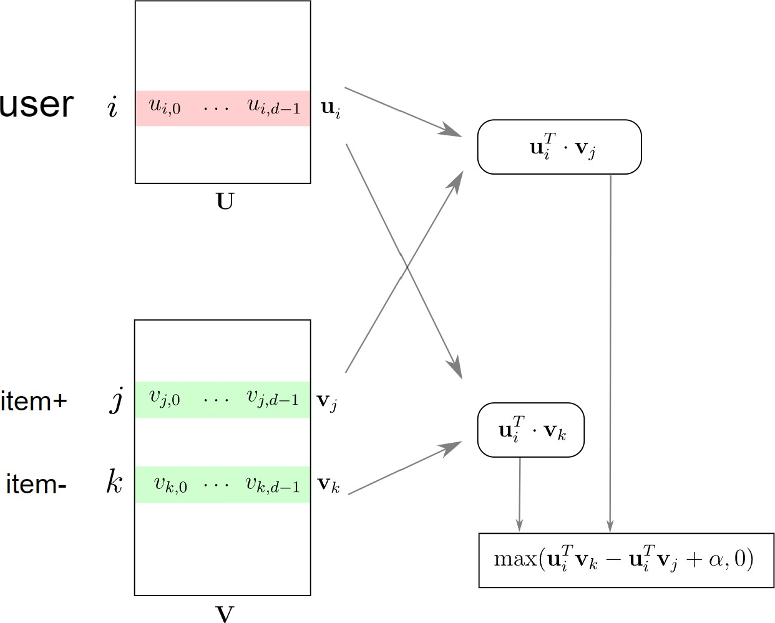
Implicit Feedback: Triplet loss

Slide 52
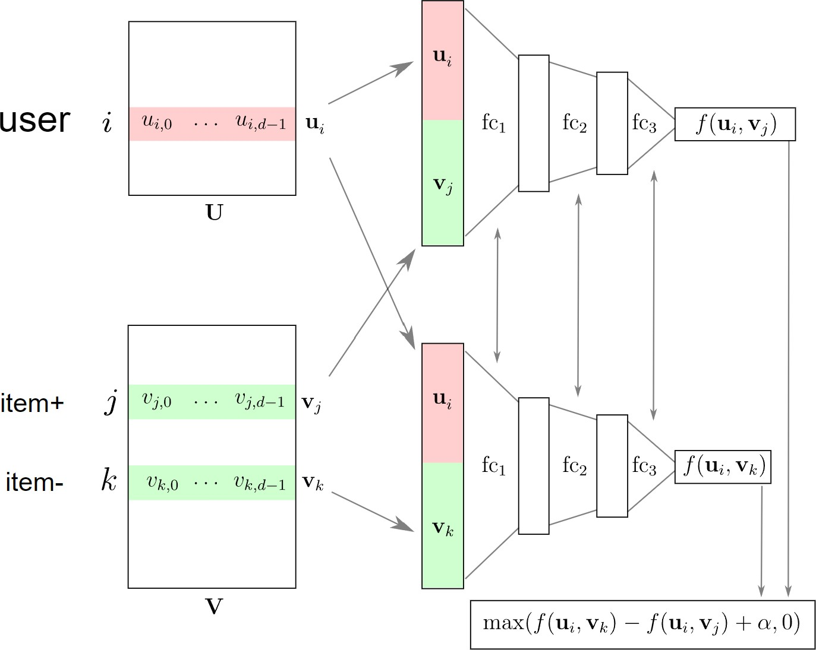
Deep Triplet Networks

Slide 53
Training a Triplet Model
Gather a set of positive pairs user i and item j
While model has not converged:

Slide 54
Training a Triplet Model
Gather a set of positive pairs user i and item j
While model has not converged:
Shuffle the set of pairs (i, j)

Slide 55
Training a Triplet Model
Gather a set of positive pairs user i and item j
While model has not converged:
Shuffle the set of pairs (i, j)
For each (I,j):
Sample item k uniformly at random

Slide 56
Training a Triplet Model
Gather a set of positive pairs user i and item j
While model has not converged:
Shuffle the set of pairs (i, j)
For each (I,j):
Sample item k uniformly at random
Call item k a negative item for user I

Slide 57
Training a Triplet Model
Gather a set of positive pairs user i and item j
While model has not converged:
Shuffle the set of pairs (i, j)
For each (I,j):
Sample item k uniformly at random
Call item k a negative item for user I
Train model on triplet (I, j, k)

Slide 58
Training a Triplet Model
Gather a set of positive pairs user i and item j
While model has not converged:
Shuffle the set of pairs (i, j)
For each (I,j):
Sample item k uniformly at random
Call item k a negative item for user I
Train model on triplet (I, j, k)

Slide 59
Deep Neural Networks for YouTube
Recommendations https://research.google.com/pubs/pub45530.html

Slide 60
Ethical Considerations of Recommender Systems

Slide 61

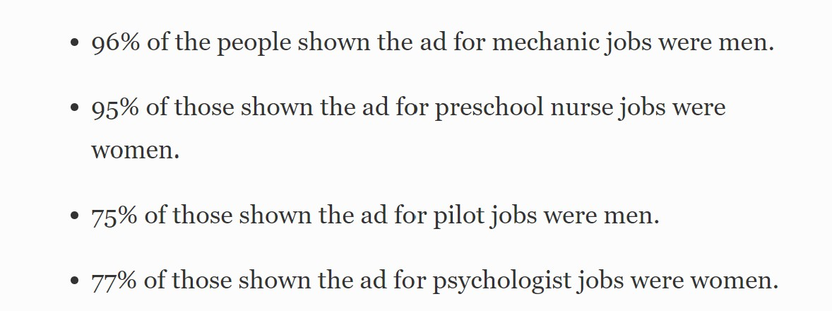
Ethical Considerations of Recommender Systems
Amplification of existing discriminatory and unfair behaviors / bias
Example: gender bias in ad clicks (fashion / jobs)
Using the firstname as a predictive feature
Amplification of the filter bubble and opinion polarization
Personalization can amplify "people only follow people they agree with"
Optimizing for "engagement" promotes content that cause strong emotional reaction (and turns normal users into haters?)
RecSys can exploit weaknesses of some users, lead to addiction
Addicted users clicks over-represented in future training data

Slide 62
Call to action
Designing Ethical Recommender Systems
Wise modeling choices (e.g. use of "firstname" as feature)
Conduct internal audits to detect fairness issues: SHAP, Integrated Gradients
Learning representations that enforce fairness?

Slide 63
Call to action
Designing Ethical Recommender Systems
Wise modeling choices (e.g. use of "firstname" as feature)
Conduct internal audits to detect fairness issues: SHAP, Integrated Gradients
Learning representations that enforce fairness?
Transparency
Educate decision makers and the general public
How to allow users to assess fairness by themselves?
How to allow for independent audits while respecting the privacy of users?

Slide 64
Call to action
Designing Ethical Recommender Systems
Wise modeling choices (e.g. use of "firstname" as feature)
Conduct internal audits to detect fairness issues: SHAP, Integrated Gradients
Learning representations that enforce fairness?
Transparency
Educate decision makers and the general public
How to allow users to assess fairness by themselves?
How to allow for independent audits while respecting the privacy of users?
Active Area of Research

